Slide 1
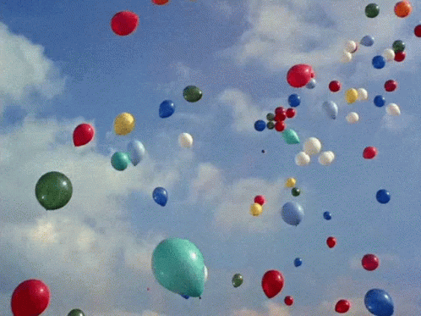
ECHOES FROM THE CHAPTER HALL
THE CONCLUDING DAY
23.02.2025

Slide 2
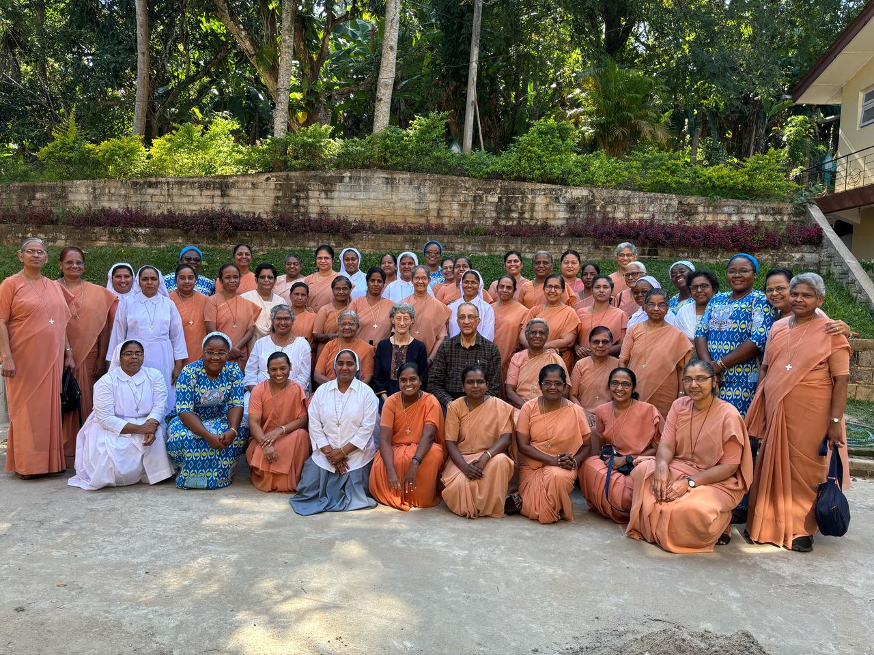

Slide 3
THANK YOU!

